Slide 1
Machine Learning
The bag-of-words model is a simplifying representation used in natural language processing and information retrieval (IR).
Go through all the data, and create a dictionary
Go through the data again, for each tweet, count the words frequency in the order of dictionary W.
Use this matrix as our training data.

Slide 2
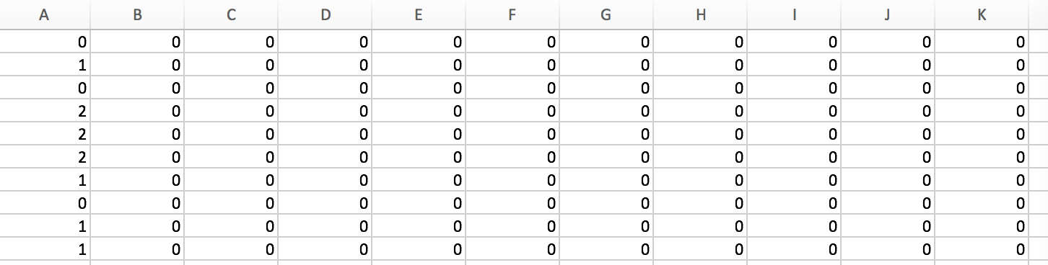
Word bag matrix
Each row represents the word frequency of each tweets.
Each attributes (column) are the word dictionary in step1
We have over 7000 attributes.

Slide 3
Machine Learning part 1
Objective of this part:
Use spark.mllib package to build different machine learning models including logistic regression, decision trees, random forests, naive Bayes to predict tweets sentiments
Preprocess the class label of original data set, which is 3 class labels including positive, neutral and negative
Again preprocess the class label of original data set, which is 12 class labels this time including positive, neutral and 10 different kinds of negative reasons.

Slide 4
Preprocess data
1. build a matrix of word bag for each tweets with class label, and we could directly use the matrix to train the models
2. logistic regression, decision trees, random forests this three use the libsvmfile to read data, so we use a python file to preprocess the input matrix and get the corresponding files to build model.

Slide 5
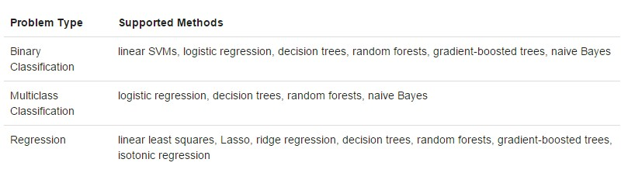
Technique:
The spark.mllib package supports various methods for binary classification, multiclass classification, and regression analysis.

Slide 6
Logistic regression
Logistic regression measures the relationship between the categorical dependent variable and one or more independent variables by estimating probabilities using a logistic function.

Slide 7
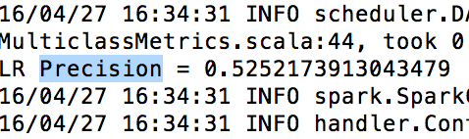
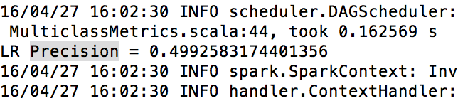
Accuracy of Logistic regression
3 class label
12 class label

Slide 8
Decision trees:
The decision tree is a greedy algorithm that performs a recursive binary partitioning among features. Each partition is chosen greedily by selecting the best split from a set of possible splits, in order to maximize the information gain at a tree node. And the recursive tree construction stopped at a node when it meets specific conditions.

Slide 9
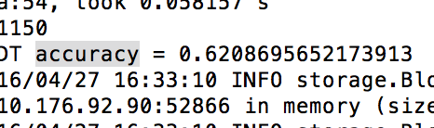
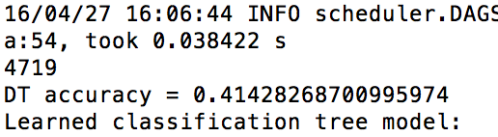
Accuracy of Decision tree
3 class label
12 class label

Slide 10
Random forests
Random forests are ensembles of decision trees. They combine many decision trees in order to gain accuracy while reduce the risk of overfitting.

Slide 11
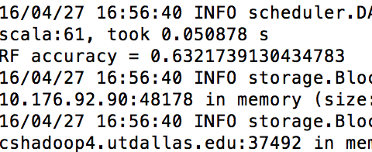
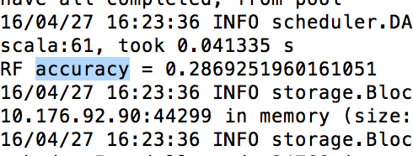
Accuracy of Random forest
3 class label
12 class label

Slide 12
Naïve Bayes:
Naive Bayes computes the conditional probability distribution of each feature given label, and then it applies Bayes’ theorem to compute the conditional probability distribution of label given an observation and use it for prediction

Slide 13
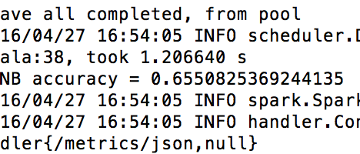

Accuracy of Naïve Bayes
3 class label
12 class label

Slide 14
Conclusion
 | 3 class | 12 class
Decision trees | 0.6207 | 0.4143
Naïve Bayes | 0.6550 | 0.3785
Random forests | 0.6332 | 0.2869
Logistic regression | 0.5252 | 0.4993
significant better result in 3 class labels than that of 12 class labels
even human will have a hard time to label different tweets, especially to classify the reason of negative sentiments, it is extremely easy for a machine learning algorithm to mismatch negative reasons for an ambiguity tweet

Slide 15
Can we do better?

